Slide 1
Context Free Grammar

Slide 2
Formal Definition of Context Free Grammars (CFG)
A CFG is a mathematical object, G, with four components, G = (N, T, P, S), where:
N is a nonempty, finite set of non-terminal symbols
T is a finite set of terminal symbols
P is a set of grammar rules, each of one having one of the forms A → α Where A ∈ N and α ∈ (N ∪ T)*
S is the start symbol S ∈ N
Example
Let G = ({S},{0,1,ε},P,S) be a CFG, where productions are S→ 0S0/1S1/ε

Slide 3
Context Free Language
Let G = (N, T, P, S) be a context free grammar.
The language generated by G is defined as L(G).
The language L is called context free language CFL if L(G) is for CFG.
Example: Construct a CFG representing the set of palindromes over (0+1)*
L(G) = {ε,0,1,00,11,000,111,010,101,0000,1111,00100,11011, 01110,10101,....}
The CFG for a palindrome is given by S → 0 / 1 / ε S → 0S0 / 1S1

Slide 4
Construct a CFG for the language L = { a^{n}; n is odd}.
The possible strings are {ε, a, aaa, aaaaa, aaaaaaa, ....}
The productions are G: S → a / aaS
Construct a CFG for the language L = { a^{n}b^{n}; n ≥ 0}.
The possible strings are {ε, ab, aabb, aaabbb, aaaabbbb, ....}
The productions are G: S → ab / aSb / ε
Construct a CFG for the language L = { 0^{n}1^{n}; n ≥ 1}.
The possible strings are {01, 0011, 000111, 00001111, ....}
The productions are G: S → 01 / 0S1
Construct a CFG for the language L = {a^{n}cb^{n} ; n ≥ 0}.
The possible strings are {c, acb, aacbb, aaacbbb, aaaacbbbb, ....}
The productions are G: S → c / aSb
Construct a CFG for the language L = { wcw^{r}; w ∈ (a+b)*}.
The possible strings are {c, aca, bcb, abcba, aacaa, bbcbb, bacab, abacaba, bbacabba,….}
The productions are G: S → aSa / bSb / c

Slide 5
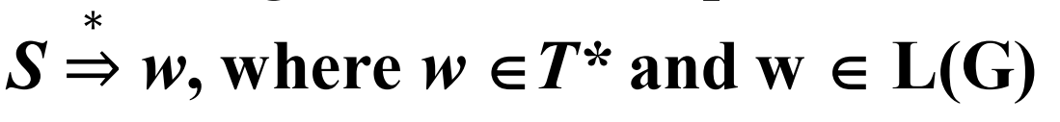
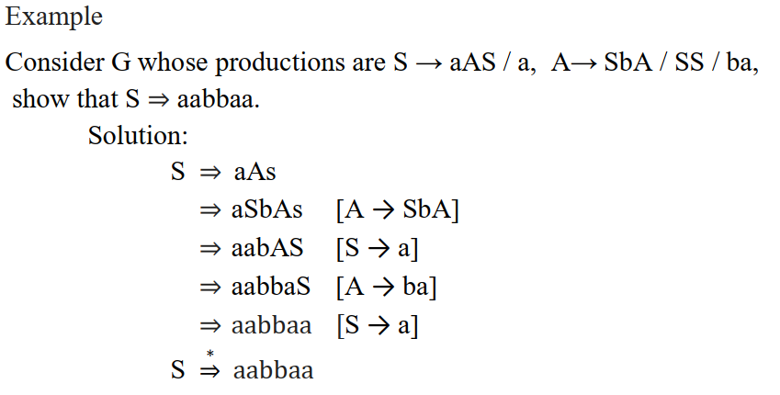
Derivations
A derivation of a string for a grammar is a sequence of grammar rule applications that transform the start symbol into the string.
A derivation proves that the string belongs to the grammar's language.

Slide 6


Leftmost derivation (LMD)
A leftmost derivation is obtained by applying production to the leftmost variable or non-terminal in each step.
Rightmost derivation (RMD)
A rightmost derivation is obtained by applying production to the rightmost variable or non-terminal in each step.

Slide 7
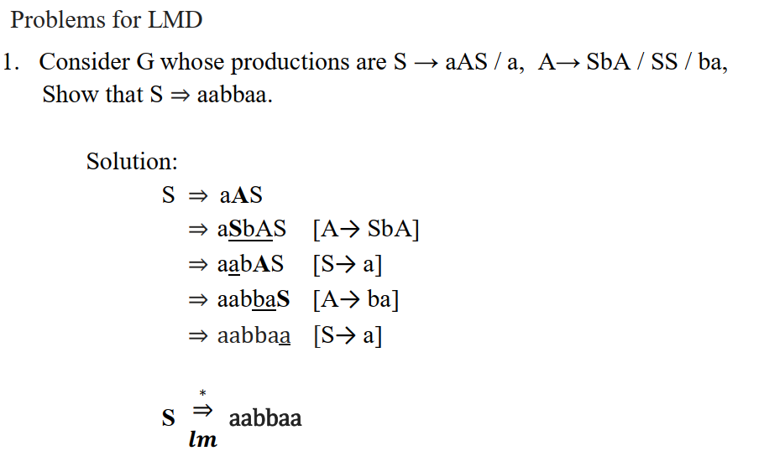

Slide 8
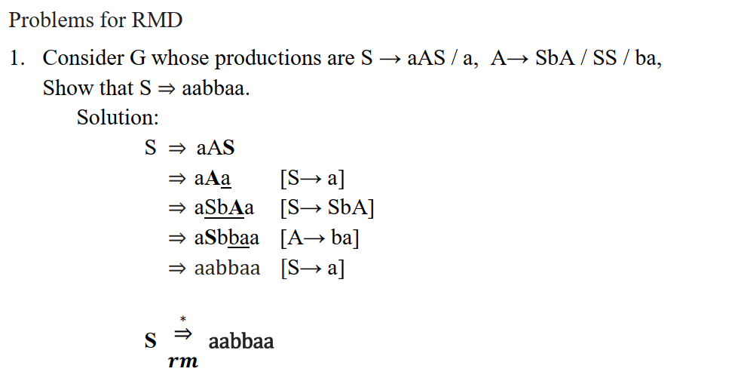

Slide 9
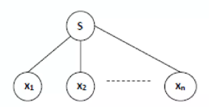
Derivation Tree or Parse Tree
Pictorial representation of derivation.
A derivation tree or parse tree is an ordered rooted tree that graphically represents the semantic information a string derived from a context-free grammar
Representation Technique
Root vertex - Must be labelled by the start symbol.
Vertex - Labelled by a non-terminal symbol.
Leaves - Labelled by a terminal symbol or ε.
If S → x1 x2 ….xn is a production rule in a CFG, then the parse tree/ derivation tree will be as follows:

Slide 10
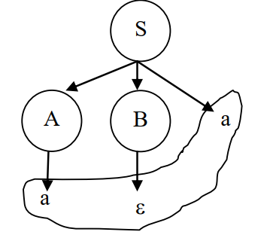
Derivation or Yield of a Tree
The derivation or yield of a tree is the final string obtained by concatenating the labels of leaves of the tree from left to right, ignoring the nulls.
However, if all the leaves are null, then derivation is null.
String: aa

Slide 11
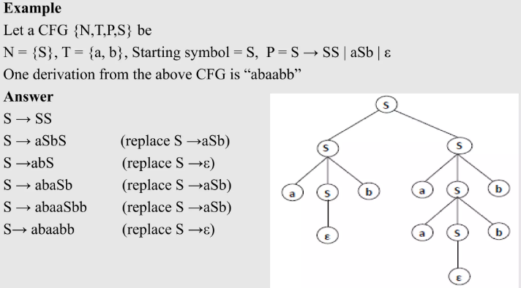

Slide 14
Type of Derivation Tree
Leftmost derivation tree A leftmost derivation tree is obtained by applying production to the leftmost vertex in each step.
Rightmost derivation tree A rightmost derivation tree is obtained by applying production to the rightmost vertex in each step.

Slide 15
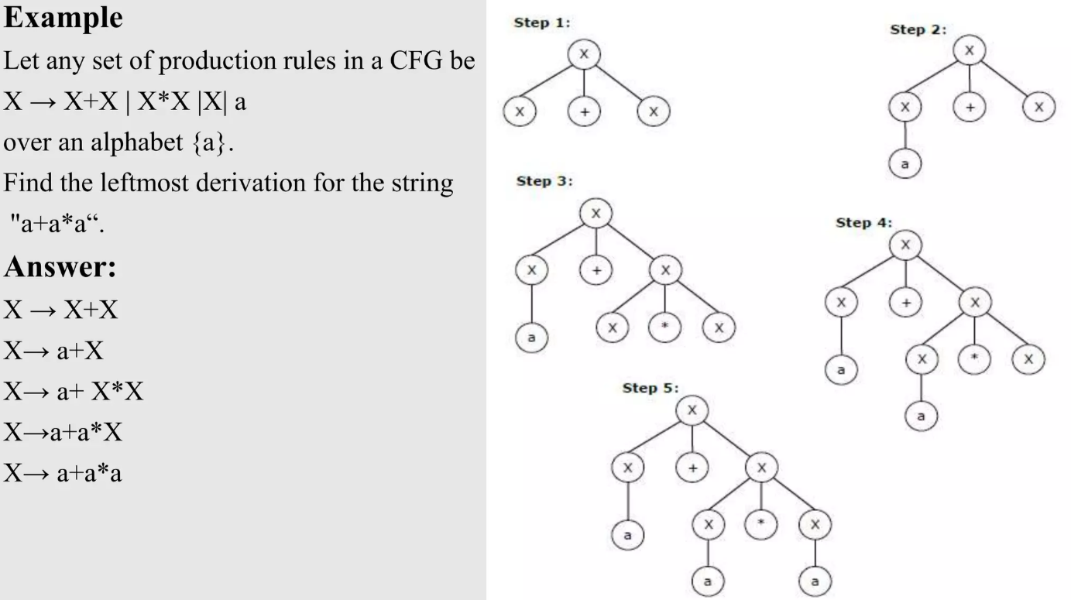

Slide 18
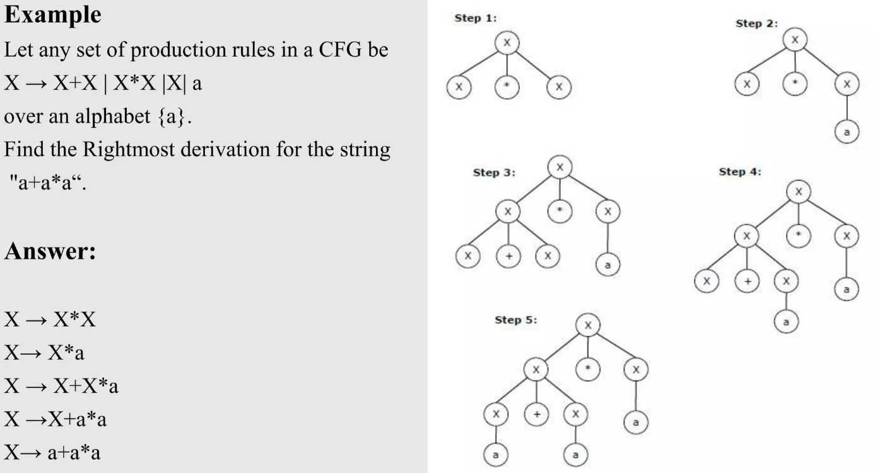

Slide 20
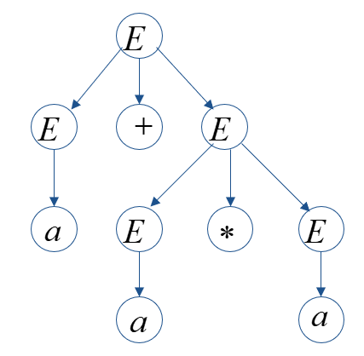
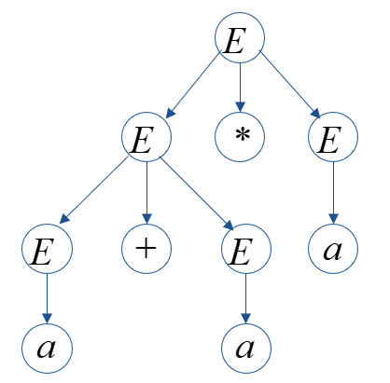
Ambiguity in Context Free Grammar
If a context free grammar G has more than one derivation tree (leftmost or rightmost derivation tree) for some string w∈L(G), it is called an ambiguous grammar.
There exist multiple right-most or left-most derivations for some string generated from that grammar.
Example: Check whether the grammar G with production rules − E → E+E | E*E |E| a is ambiguous or not.
Solution: Let’s assume a string w = a+a*a
Parse tree 1 −
Parse tree 2 −
Derivation 1
E → E+E
→ a +E
→ a+ E*E
→ a+a*E
→ a+a*a
Derivation 2
E → E*E
→ E+E*E
→ a+ E*E
→ a+a*E
→ a+a*a
Note: There is no direct algorithms to find whether grammar is ambiguous or not.

Slide 21
Associativity and Precedence of Operators in CFG
To solve the problem of ambiguity, extra restrictions such as associativity and precedence should be added to obtain only one parse tree for the input expression.
Precedence determines the order of operations in an expression. Higher precedence operations are performed before lower precedence ones.
Associativity defines the direction in which operations of the same precedence are evaluated.
Left-associative operations are evaluated from left to right, while right-associative operations are evaluated from right to left.
Left Associativity (Addition):
Expression: 2 + 3 + 4
Left-associative addition evaluates from left to right:
First, it adds 2 + 3 as 5.
Then, it adds 5 + 4 as 9.
Right Associativity (Exponentiation):
Expression: 2 ^ 3 ^ 2
Right-associative exponentiation evaluates from right to left:
First, it evaluates 3 ^ 2 as 9.
Then, it evaluates 2 ^ 9 as 512.

Slide 22
Removing ambiguity by precedence & associativity rules
1. Precedence: If different operators are used, we will consider the precedence of the operators. The three important characteristics are:
1. The level at which the production is present denotes the priority of the operator used.
2. The production at higher levels will have operators with less priority. In the parse tree, the nodes which are at top levels or close to the root node will contain the lower priority operators.
3. The production at lower levels will have operators with higher priority. In the parse tree, the nodes which are at lower levels or close to the leaf nodes will contain the higher priority operators.

Slide 23
2. Associativity -If the same precedence operators are in production, then we will have to consider he associativity.
1. If the associativity is left to right, then we have to prompt a left recursion in the production. The parse tree will also be left recursive and grow on the left side.
+,-,*,/ are left associative operators.
2. If the associativity is right to left, then we have to prompt the right recursion in the productions. The parse tree will also be right recursive and grow on the right side.
^ is a right associative operator.

Slide 24
Given Grammar
E → E+E
E → E*E
E → a
Remove ambiguity from the given grammar.
Solution:
Precedence: * has the higher priority than +. Hence , it should be at a lower level, so we should start with +
Associativity: + and * both are left associative
E → E+P | P
P → P*Q |Q
Q → a

Slide 25
E → E + E
E → E * E
E → E ^ E
E →id
Remove ambiguity from the given grammar.
Solution: Operator +,* and ^
Precedence: ^ > * > +
Associativity : *, + -> left to right
^ -> right to left
We need to arrange the grammar so that the production with ^ and * are in lower levels of the parse tree and every production must follow the associativity of its operator.
Unambiguous Grammar:
E → E + P | P
P → P * Q | Q
Q → R ^ Q | R
R → id

Slide 26
Inherently ambiguous language
A context-free language is called inherently ambiguous if there exists no unambiguous grammar to generate the language.
L = {a^{i} b^{j} c^{k} | i = j or j = k}
L = {a^{i} b^{i} c^{j} d^{j}} ∪ {a^{i} b^{j} c^{j} d^{i}}

Slide 27
Simplification of CFGs
In a CFG, it may happen that all the production rules and symbols are not needed for the derivation of strings.
Besides, there may be some null productions, useless symbols and unit productions.
Elimination of these productions and symbols is called simplification of CFGs or reduction of grammar.
The properties of reduced grammar are given below:
Each variable (i.e. non-terminal) and each terminal of G appears in the derivation of some word in L.
There should not be any production as X → Y where X and Y are non-terminal.
If ε is not in the language L then there need not to be the production X → ε.

Slide 28
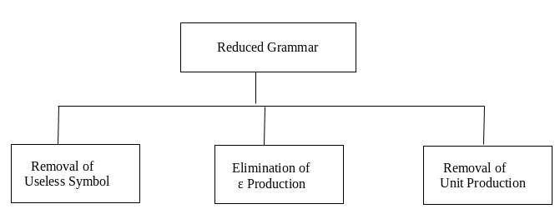
Simplification essentially comprises of the following steps
Elimination of Useless Symbols or Productions
Elimination of Null Productions (ie. ε)
Elimination of Unit Productions

Slide 29
Removal of Null/Empty (ε) Production
The productions of type “A→ ε” are called ε productions.
These type of productions can only be removed from those grammars that do not generate ε.
Procedure for Removing Null Production:
Identify the ε-production in given CFG ( in form A→ ε).
To eliminate A→ ε, write all productions from CFG whose right side contains A.
Replace each occurrence of A with “ε” to get productions without “ε” and eliminate A→ ε.
The obtained productions in step3 must be added to the grammar.
A→ ε is allowed only if A is not used on RHS of any production.

Slide 30
Example:
Remove the null production from the following CFG by preserving the meaning of it.
S → XYX
X → 0X | ε
Y → 1Y | ε
Solution: There are two null productions X → ε and Y → ε. To preserve the meaning of CFG, placing ε at the right-hand side whenever X and Y have appeared.
Remove X → ε
S → XYX
If the first X at right-hand side is ε. Then S → YX
Similarly, if the last X in R.H.S. = ε. Then S → XY
If both X are replaced by ε. Then S → Y Therefore, S → XY | YX | Y
X → 0X
If we place ε at right-hand side for X then, X → 0X | 0
2. Remove Y → ε
S → XYX| XY | YX | Y
If Y = ε then S → XX | X| ε
Y → 1Y
If we place ε at right-hand side for Y then Y → 1Y | 1
After removing X → ε :
S → XYX| XY | YX | Y
X → 0X | 0
Y → 1Y | ε
If we do not include S → ε, then obtained grammar will be L(G ) − {ε}
After removing Y → ε :
S → XYX|XY | YX |XX|X| Y| ε
X → 0X | 0
Y → 1Y | 0

Slide 31
Example:
Remove the null production from the following CFG by preserving the meaning of it.
S → ABaC
A → BC
B → b | ε
C → D | ε
D → d
Solution: There are two null productions B → ε and C → ε. To preserve the meaning of CFG, placing ε at the right-hand side whenever B and C have appeared.
Remove B → ε
S → ABaC | AaC
A → BC | C
B → b
C → D | ε
D → d
2. Remove C → ε
S → ABaC | AaC | ABa | Aa
A → BC | C | B | ε
B → b
C → D
D → d
As the last step generate one new null production A → ε
3. Remove A → ε
S → ABaC | AaC | ABa | Aa | BaC | aC | Ba | a
A → BC | C | B
B → b
C → D
D → d

Slide 32
Removing Unit Productions
Any production of the form A → B is called a unit production where A,B ∈ Non-terminal.
A unit production maybe defined as a production which contains single non-terminals on both sides.
Unit productions can be removed without affecting the language generation power of the grammar.
Procedure to remove unit productions:
To remove A → B , add production A → x to the grammar rule whenever B → x occurs in the grammar.
Delete A → B from the grammar.
Repeat from step 1 until all the unit productions are removed.

Slide 33
Example:
Remove the unit production from the following CFG by preserving the meaning of it.
S → 0A | 1B | C
A → 0S | 00
B → 1 | A
C → 01
Solution: There are 2-unit productions S → C and B → A.
Remove S → C
S → 0A | 1B | C
After removing the unit production C will be replaced by 01. Then S → 0A | 1B | 01
2. Remove B → A
B → 1 | A
After removing the unit production, A will be replaced by 0S | 00. Then B → 1 | 0S | 00
Final CGF without unit productions:
S → 0A | 1B | 01
A → 0S | 00
B → 1 | 0S | 00
C → 01

Slide 34
Example:
Remove the unit production from the following CFG by preserving the meaning of it.
S → Aa | B
B → A | bb
A → a | bc | B
Solution: There are 3-unit productions S → B, B → A and A → B
Remove S → B
S → Aa | A | bb
B → A | bb
A → a | bc | B
2. Remove B → A
S → Aa | A | bb
B → a | bc | bb
A → a | bc | B
3. Remove A → B
S → Aa | A | bb
B → a | bc | bb
A → a | bc | bb
4. Remove S → A
S → Aa | a | bc | bb
B → a | bc | bb
A → a | bc | bb

Slide 35
Elimination of Useless Symbols or Productions
The productions that can never take part in derivation of any string are called useless productions.
Similarly, a symbol can be useless if it does not appear on the right-hand side of the production rule and does not take part in the derivation of any string.
Simply removing variables (non-terminals) and productions
Can never derive a terminal string (non-generating symbols).
Can never be reached from the start symbol (unreachable symbols).
Note: First eliminate non-generating symbol and productions involving one or more of those symbol. Second, eliminate all the symbols that are not reachable in the grammar.

Slide 36
For example: Remove the useless production from the following CFG
T → aaB | abA | aaT
A → aA
B → ab | b
C → ad
Solution:
Production C → ad is useless, so we will eliminate it. (unreachable symbols)
Production A → aA is also useless because there is no way to terminate it .(non-generating symbols).
Therefore, final CFG is
T → aaB | aaT
B → ab | b

Slide 37
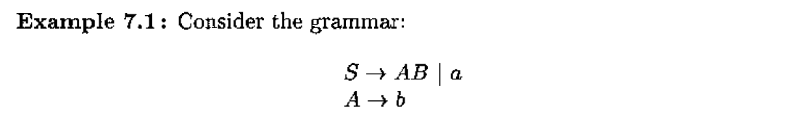

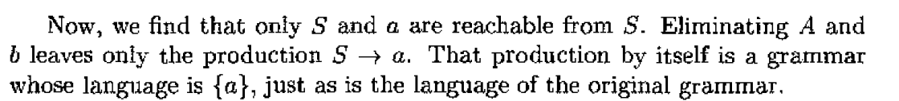
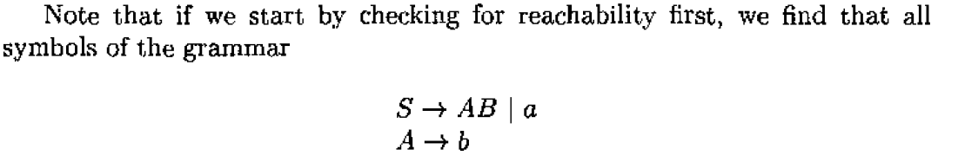
Solution: B is non-generating symbols, we must eliminate the production S → AB, leaving the grammar

Slide 38
Order of Elimination
We must follow the following order of eliminations.
Eliminate null productions
Eliminate unit productions
Eliminate useless symbols

Slide 39
Simplify the following CFG
S → ABC | BaB
A → aA | BaC | aaa
B → bBb | a | D C → CA | AC
D → ε
Step 1 : Removal of ε Productions
The given grammar contains two nullable productions. Variables D (directly nullable) and B (indirectly nullable)
i. Remove D → ε
S → ABC | BaB
A → aA | BaC | aaa
B → bBb | a | D | ε C → CA | AC
ii. Remove B → ε
S → ABC | BaB | AC | Ba | aB | a
A → aA | BaC | aaa | aC
B → bBb | a | D | bb C → CA | AC
Step 2 : Removal of Unit Productions
The given grammar contains a single unit production ( B → D).
Remove B → D
S → ABC | BaB | AC | Ba | aB | a
A → aA | BaC | aaa | aC
B → bBb | a | bb C → CA | AC
Note: Here, D derives nothing so removing B -> D is simply deleted.

Slide 40
Step 3 : Removal of useless symbols
Symbol C is non-generating, so it will be removed. Now, the resultant grammar after removing non-generating symbol C is as follows:
S → BaB | Ba | aB | a
A → aA | aaa
B → bBb | a | bb
Next, grammar contains an unreachable symbol A.
Resultant grammar after unreachable symbol:
S → BaB | Ba | aB | a
B → bBb | a | bb

Slide 41
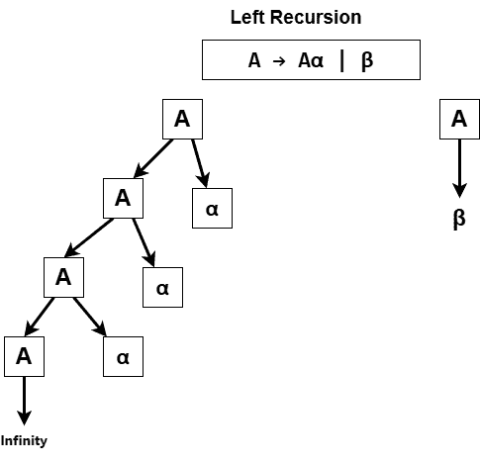
Removal of Left Recursion
A context-free grammar is said to be left recursive if it contains a production rule where the non-terminal on the left-hand side of the rule also appears as the first symbol on the right-hand side.
the grammar is trying to define a non-terminal in terms of itself, creating a recursive loop.
A→Aα|β

Slide 42
Elimination of Left Recursion
If the left-recursive pair of productions- A → Aα / β
Where −
A is a non-terminal symbol.
α represents a sequence of terminals and/or non-terminals.
β represents another sequence of terminals and/or non-terminals, where β does not begin with an A.
Then, we can eliminate left recursion by replacing the pair of productions with-
A → βA’
A’ → αA’ / ∈
Elimination of
left recursion
A → βA’
A’ → αA’ / ∈
A → Aα / β

Slide 43
Example: Remove left recursion from the following
Grammar: E→E+T|T
T→T∗F|F
F→(E)|id
Solution: This grammar contains left recursion in the rules for both `E` and `T`.
Eliminating Left Recursion in `E`:
E→TE′
E′→+TE′|ε
Eliminating Left Recursion in `T`:
T→FT′
T′→∗FT′|ε
The final transformed grammar, free from left recursion, becomes −
E→TE′
E′→+TE′|ε
T→FT′
T′→∗FT′|ε
F→(E)|id
Elimination of
left recursion
A → βA’
A’ → αA’ / ∈
A → Aα / β

Slide 44
Removal of Left Factoring
A grammar has left factoring problem if two or more productions share a common prefix. Such as
A→αβ₁|αβ₂|…|αβ_{n}|γ
This creates ambiguity for predictive parsers when choosing which rule to apply.
Elimination of Left Factoring:
A→αA′|γ
A’→β₁|β₂|…|β_{n}

Slide 45
Normal Forms
A CFG is convert into a specific form is called as Normal forms.
There are two types of Normal Norms.
Chomsky Normal Form (CNF)
Greibach Normal Form (GNF)

Slide 46
Chomsky Normal Form (CNF)
In CNF, we have restrictions on the length of RHS and symbols in RHS of productions.
A CFG(context free grammar) is in CNF(Chomsky normal form) if all production rules satisfy one of the following conditions:
A non-terminal generating two non-terminals. For example, A → BC.
A non-terminal generating a terminal. For example, A → a.
Note: Start symbol generating ε (S → ε) will be in G if ε is in L(G) and S does not appear on RHS of any production.

Slide 47
Steps for converting CFG into CNF
Step 1: Simplify the given CFG, Elimination of null production, elimination of unit production and elimination of useless production.
Step 2: Replace each production A → B1…Bn where n > 2 with A → B1C. Where C → B2 …Bn. Repeat this step for all productions having more than two non-terminals in the right side.
Step 3: If the right side of any production is in the form A → aB where a is a terminal and A, B are non-terminal, then the production is replaced by A → XB and X → a. Repeat this step for every production which is in the form A → aB.

Slide 48
Example: Convert the given CFG to CNF. Consider the given grammar G1:
S → bA / aB
A → bAA / aS / a
B → aBB / bS / b.
Solution: Step 1: there is no null production, unit production and useless production.
Step 2: Find the productions which are already in CNF.
A → a
B → b
Step 3: Replace all remaining productions into CNF.
S → bA S → C_{b}A C_{b} → b
S → aB S → C_{a}B C_{a} → a
A → bAA A → C_{b}D₁ D₁ → AA C_{b} → b
iv. A → aS A → C_{a}S C_{a} → a
v. B → aBB B → C_{a} D₂ D₂ → BB C_{a} → a
vi. B → bS B → C_{b}S C_{b} → b
Final Resultant Grammar G1: S → CbA / CaB A → CbD1 / CaS / a B → Ca D2 / CbS / b D1 → AA D2 → BB Ca → a Cb → b

Slide 49
Example: Convert the given CFG to CNF. Consider the given grammar G1:
S →aAbB
A → aA |a
B →bB|b
Solution: Step 1: There is no unit production or null production.
Step 2: Find the productions which are already in CNF.
A →a
B →b
Step 3: Replace all remaining productions into CNF.
i. S → aAbB
C_{a} → a
C_{b} → b
S →C_{a}AC_{b}B
S → C_{a}D₁
D₁ →AC_{b}B
D₁ →AD₂
D₂ →C_{b}B
ii. A →aA
A →C_{a}A
iii. B →bB
B →C_{b}B
Final Resultant Grammar G1: S → C_{a}D₁
D₁ →AD₂
D₂ →C_{b}B
A →C_{a}A|a
B →C_{b}B|b
C_{a} → a
C_{b} → b

Slide 50
Consider the CFG and convert it into CNF:
S → aXbX
X → aY | bY | ε
Y → X |c| ε
Solution: The variable X and Y are nullable. After elimination of ε, we obtain:
S → aXbX | abX | aXb | ab
X → aY | bY | a | b
Y → X | c
After elimination of the unit production Y → X, we obtain:
S → aXbX | abX | aXb | ab
X → aY | bY | a | b
Y → aY | bY | a | b | c
i) S → aXbX | abX | aXb | ab
C_{a} → a
C_{b} → b
S → C_{a}XC_{b}X | C_{a}C_{b}X | C_{a}XC_{b} | C_{a}C_{b}
S → C_{a}D₁ | C_{a}D₂ | C_{a} D₃ | C_{a}C_{b}
D₁ → X D₂
D₂ →C_{b}X
D₃ → XC_{b}
Final Grammar:
S → C_{a}D₁ | C_{a}D₂ | C_{a} D₃ | C_{a}C_{b}
D₁ → X D₂
D₂ →C_{b}X
D₃ → XC_{b}
X → C_{a}Y | C_{b}Y |a | b
Y → C_{a}Y | C_{b}Y |a | b |c
C_{a} → a
C_{b} → b
ii) X → aY | bY | a | b
X → C_{a}Y | C_{b}Y |a | b
iii) Y → aY |bY| a | b| c
Y → C_{a}Y | C_{b}Y |a | b |C

Slide 51
Convert the following grammar to CNF:
S → SS | (S) | ε
Solution: Step 1: Add a new start symbol (since S → ε and S is on RHS)
S₀ → S | ε
Updated Grammar:
S₀ → S | ε
S → SS | (S) | ε
Step 2: Remove ε-productions (nullable symbol is S)
S₀ → S | ε
S → SS | ( S ) | S | ( )
Step 3: Eliminate unit productions
S₀ → S | ε
S → SS | ( S ) | ( )
Step 4: Convert RHS to CNF (2 non-terminals or 1 terminal)
S₀ → S | ε
S → SS | A C | A B
C → S B
A → (
B → )

Slide 52
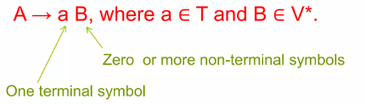
Greibach Normal Form (GNF)
A context free grammar generated by a pushdown automata is in GNF.
A CFG is in Greibach Normal Form (GNF) if every production is in following form:
1. A non-terminal generating a terminal which is followed by any number of non-terminals. For example: A → aα*, where α ∈ N* (maybe null) and a ∈ Σ.
2. A non-terminal generating a terminal. For example, A → a.
Note: Start symbol generating ε (S → ε) will be in G if ε is in L(G) and S does not appear on RHS of any production.

Slide 53
For converting the given grammar to GNF, we use 2 theorems:
Theorem 1: Substitution Rule: If there is a production rule A → α B γ and B → β₁ |β₂| . . . | β_{n}.
Then equivalent grammar can be obtained by substituting B in A. then resultant grammar will be: A → α β₁ γ | α β₂ γ | α β₃ γ | ……. α β_{n} γ
Theorem 2: Elimination of left recursion: A grammar of form A → Aα / β is called left recursive which will be eliminated by rewriting the grammar as
A → βZ
Z → αZ / ∈
If we eliminate ∈ production, then we get:
A → βZ | β
Z → αZ / α
We can generalize this grammar. If there is CFG productions as: A → Aα₁ | Aα₂ | Aα₃ | …. Aα_{n} | β₁ |β₂| . . . | β_{n}
Then equivalent grammar without left recursion will be :
A → β₁ Z|β₂Z| . . . | β_{n} Z| β₁ |β₂| . . . | β_{n}
Z → α₁Z | α₂Z | α₃Z | ……..| α₁ |α₂ | α_{3 …..}

Slide 54
Steps for converting CFG into GNF
1. Simplify the grammar (eliminate null symbol, unit production and useless symbols) and convert it into Chomsky normal form (CNF)
2. Change the names of non terminal symbols to A₁ till A_{N} in same sequence.
3. Check for every production rule of form A_{i} → A_{j} X and apply the following
If j > i, then leave the production rule as it is.
If j = i , then apply elimination of left recursion rule.
If j < i, then apply substitution rule.
4. For each production rule of form A_{i} → A_{j} X, where j > i, apply the substitution rule if A_{j} is in GNF, to bring A_{i} to GNF.

Slide 55
Example: Consider the given Grammar and convert it into GNF
S → XA | BB
B → b | SB
X → b
A → a
Solution: Step 1: there is no null production, unit production and useless production. And grammar is already in CNF.
Step 2: For converting a CNF to GNF first rename the non terminal symbols to A₁,A₂ till A_{N} in same sequence as they are used.
A₁ = S
A₂ = X
A₃ = A
A₄ = B
Therefore, now the new production rule is,
A₁ → A₂A₃ | A₄A₄
A₂ → b
A₃ → a
A₄ → b | A₁A₄
Now, check for every production A_{i} → A_{j} X, where X can be any number of terminal symbols. If i<j in the production then it is good to go to the next step but if i>j then change the production by replacing it with that terminal symbol’s production. if i=j then it is a left recursion and you need to remove left recursion.

Slide 56
So, substitute A₁’s production rule.
A₁ → A₂A₃ | A₄A₄
A₂ → b
A₃ → a
A₄ → b | A₂A₃A₄ | A₄A₄A₄
Subtitute A₂
A₁ → A₂A₃ | A₄A₄
A₂ → b
A₃ → a
A₄ → b | bA₃A₄ | A₄A₄A₄
Here A₄A₄A₄ in production rule of A₄ is the example of left recursion.
So, it will be eliminated as
A₄ → bZ | bA₃A₄Z
Z → A₄A₄ | A₄A₄Z
And resultant grammar will become:
A₁ → A₂A₃ | A₄A₄
A₂ → b
A₃ → a
A₄ → b | bA₃A₄ | bZ | bA₃A₄Z
Z → A₄A₄ | A₄A₄Z
If there is CFG productions as:
A → Aα₁ | Aα₂ | Aα₃ | …. Aα_{n} | β₁ |β₂| . . . | β_{n}
Then equivalent grammar without left recursion will be :
A → β₁ Z |β₂Z | . . . | β_{n} Z| β₁ |β₂| . . . | β_{n}
Z → α₁Z | α₂Z | α₃Z | ……..| α₁ |α₂ | α_{3 …..}

Slide 57
The Last step is to replace the production to the form of either
A_{i} → x (any single terminal symbol)
OR
A_{i} → xX (any single terminal followed by any number of non terminals)
So here we need to replace A2 in production rule of A1 and so on.
A₁ → bA₃ | bA₄ | bA₃A₄A₄ | bZA₄ | bA₃A₄ZA₄
A₂ → b
A₃ → a
A₄ → b | bA₃A₄ | bZ | bA₃A₄Z
Z → bA₄ | bA₃A₄A₄ | bZA₄ | bA₃A₄ZA₄ | bA₄Z | bA₃A₄A₄Z | bZA₄Z | bA₃A₄ZA₄Z

Slide 58
Closure Properties of CFG
Context-free languages are closed under union, concatenation, and Kleene star.
Context-free languages are not closed under intersection or complement

Slide 59
Union: If L 1 and L2 are context-free languages, then L1∪ L2 is a context-free language
Let L₁ be language recognized by G₁ = (V₁, Σ, P₁, S₁) and
L₂ the language recognized by G₂ = (V₂, Σ, P₂, S₂). Assume that V₁ ∩ V₂ = ∅;
We will construct a grammar G = (V, Σ, R, S) such that L(G) = L(G₁) ∪ L(G₂) as follows.
V = V₁ ∪ V₂ ∪ {S}, where S ∉ V₁ ∪ V₂ (and V₁ ∩ V₂ = ∅)
P = P₁ ∪ P₂ ∪ {S → S₁| S₂}
For example: If L(G1) = {a^{n}b^{n} : n ≥ 0}. Also, L(G2) = {c^{m}d^{m} : m ≥ 0}
Then , G1: S₁ → aS₁b, S₁ → ε and G2: S₂ → cS₂d , S₂ → ε
Then L(G) = L(G1) ∪ L(G2); G = (V₁ ∪ V₂ ∪ {S}, Σ₁ ∪ Σ₂, P, S )
G: S → S₁ | S₂
S₁ → aS₁b
S₁ → ε
S₂ → cS₂d
S₂ → ε

Slide 60
Concatenation: If L 1 and L2 are context-free languages, then L1 L2 is a context-free language
Let L₁ be language recognized by G₁ = (V₁, Σ, P₁, S₁) and
L₂ the language recognized by G₂ = (V₂, Σ, P₂, S₂). Assume that V₁ ∩ V₂ = ∅;
We will construct a grammar G = (V, Σ, R, S) such that L(G) = L(G₁) L(G₂) as follows.
V = V₁ ∪ V₂ ∪ {S}, where S ∉ V₁ ∪ V₂ (and V₁ ∩ V₂ = ∅)
P = P₁ ∪ P₂ ∪ {S → S₁S₂}
For example: If L(G1) = {a^{n}b^{n} : n ≥ 0}. Also, L(G2) = {c^{m}d^{m} : n ≥ 0}
Then , G1: S₁ → aS₁b, S₁ → ε and G2: S₂ → cS₂d , S₂ → ε
Then L(G) = L(G1) L(G2); G = (V₁ ∪ V₂ ∪ {S}, Σ₁ ∪ Σ₂, P, S )
G: S → S₁ S₂
S₁ → aS₁b
S₁ → ε
S₂ → cS₂d
S₂ → ε

Slide 61
Kleen Star: If L is a context-free language, then L* is a context-free language
Let L be language recognized by G = (V₁, Σ, P₁, S₁)
Then L* will be recognized by a grammar G = (V, Σ, R, S) such that
G = (V₁ ∪ {S}, Σ, P, S) where P = P₁ ∪ {S → SS₁ | S → ε }
For example: If L(G) = {a^{n}b^{n} : n ≥ 0}.
Then , G: S₁ → aS₁b, S₁ → ε
Then (L(G))* will be recognized by G = (V₁ ∪ {S}, Σ, P, S )
G: S → SS₁ S → ε
S₁ → aS₁b
S₁ → ε

Slide 62
String Reversal: If L is a context-free language, then L^{R} is a context-free language
Let L be language recognized by G = (V, Σ, P₁, S)
Then L^{R} will be recognized by a grammar G = (V, Σ, P_{r}, S) such that
P_{r} = productions from P such that all symbols on the right-hand side of every production is reversed.
i.e., If A → α is in P, then A → α^{R} is in P
For example:
Grammar for accepting L is S → aSb | ab.
Grammar for accepting L^{R} is S → bSa | ba.

Slide 63
Theorem: CFLs are not closed under intersection: If L1 and L2 are CFLs, then L1 ∩ L2 may not be a CFL.
Proof: L1 = {a^{n} b^{n} a^{m} | n, m ≥ 0} is generated by the following
CFG: S → XA
X → aXb | ε
A → Aa | ε
L2 = {a^{n}b^{m}a^{m} | n, m ≥ 0} is generated by the following
CFG: S → AX
X → aXb | ε
A → Aa | ε
L= L1 ∩ L2 = {a^{n} b^{n} a^{n} | n ≥ 0}, is not CFL (will be prove later by pumping lemma)

Slide 64
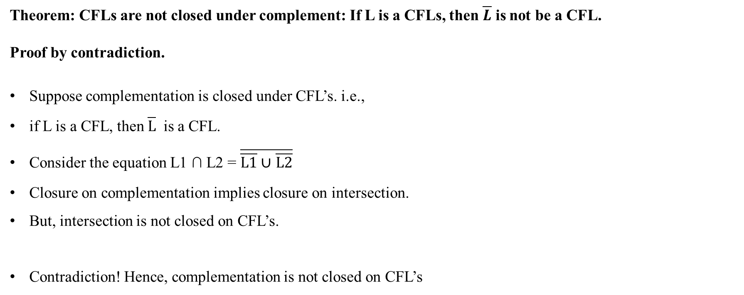

Slide 65
Important closure and non-closure properties
1. If L1 and L2 are CFL then intersection of L1 and L2 (L1 ∩ L2 ) will not be CFL. i.e. CFLs are not closed under intersection.
2. If L is a CFL and R is a regular language then L ∩ R is a CFL.
3. Context-free languages are not closed under complementation.
4. If L1 is a CFL and L2 is a CFL then L1 - L2 is not necessarily a CFL ( set difference)
5. If L is a CFL and R is a regular language then L - R is a CFL
6. Context free languages are closed under homomorphisms and inverse homomorphisms.

Slide 66
CYK algorithm

Slide 67
CYK Algorithm
CYK Algorithm is a membership algorithm of context free grammar.
It is used to decide whether a given string belongs to the language of grammar or not.
It is also known as CKY Algorithm or Cocke-Younger-Kasami Algorithm after its inventors.
In order to apply CYK algorithm to a grammar, it must be in Chomsky Normal Form.
It uses a dynamic programming algorithm to tell whether a string is in the language of a grammar.

Slide 68
Recursive Algorithm
Assume G is a CNF grammar.
S derives w ⇐⇒ one of the following holds:
|w| = 1 and S → w is a rule in P
|w| > 1 and there is a rule S → AB and a split w = uv with |u|, |v| ≥ 1 such that A derives u and B derives v

Slide 69
Construct a Triangular Table
Each row corresponds to one length of substrings
First row corresponds to substring of length 1.
Second corresponds to substring of length 2 and so on.
Each column corresponds to the start position of substring
Suppose w = aaabb
a
3
b
4
b
5
a a
i →
1
2
j ₁
Sub-string of length 1
↓ ₂
3
4
5
Sub-string of length 2
Sub-string of length 3
Sub-string of length 4
Sub-string of length 5

Slide 70
Show the CYK Algorithm with the following example:
𝑆 → 𝐴𝐵
𝐴 → 𝐴𝐴 | 𝐴𝐵 | 𝑎
𝐵 → 𝐶𝐶
𝐶 → 𝑏
w = 𝑎𝑎𝑎𝑏𝑏 (𝑛 = 5)
Is w in L(G)?

Slide 71
𝑆 → 𝐴𝐵
𝐴 → 𝐴𝐴 | 𝐴𝐵 | 𝑎
𝐵 → 𝐶𝐶
𝐶 → 𝑏
𝑥 = 𝑎𝑎𝑎𝑏𝑏 (𝑛 = 5)
Start by filling in the “top” row in the table, with the variables that directly produce the terminal symbol at the corresponding position.
a
3
b
4
b
5
a a
i →
1
2
j ₁
↓ ₂
3
4
5

Slide 72
𝑆 → 𝐴𝐵
𝐴 → 𝐴𝐴 | 𝐴𝐵 | 𝑎
𝐵 → 𝐶𝐶
𝐶 → 𝑏
𝑥 = 𝑎𝑎𝑎𝑏𝑏 (𝑛 = 5)
Start by filling in the “top” row in the table, with the variables that directly produce the terminal symbol at the corresponding position.
a
3
b
4
b
5
a a
i →
1
2
j ₁
C
↓ ₂
3
4
5
A
A
A
C
E.g. the single symbol at position 5 in the string is directly produced by variable 𝐶, so we put a 𝐶 in the
entry at column 5, row 1.

Slide 73
𝑆 → 𝐴𝐵
𝐴 → 𝐴𝐴 | 𝐴𝐵 | 𝑎
𝐵 → 𝐶𝐶
𝐶 → 𝑏
𝑥 = 𝑎𝑎𝑎𝑏𝑏 (𝑛 = 5)
Fill in subsequent rows by looking at the cells directly above and the cells diagonally to the upper right.
Substring of length 2 start with 1st position – aa
It can be generated by A A
Look for a production rules to generate AA
a
3
b
4
b
5
a a
i →
1
2
j ₁
↓ ₂
3
4
5
A | A | A | C | C
A

Slide 74
𝑆 → 𝐴𝐵
𝐴 → 𝐴𝐴 | 𝐴𝐵 | 𝑎
𝐵 → 𝐶𝐶
𝐶 → 𝑏
𝑥 = 𝑎𝑎𝑎𝑏𝑏 (𝑛 = 5)
Fill in subsequent rows by looking at the cells directly above and the cells diagonally to the upper right.
a
3
b
4
b
5
a a
i →
1
2
j ₁
↓ ₂
3
4
5
A | A | A | C | C
A | A | ∅ | B

Slide 75
𝑆 → 𝐴𝐵
𝐴 → 𝐴𝐴 | 𝐴𝐵 | 𝑎
𝐵 → 𝐶𝐶
𝐶 → 𝑏
𝑥 = 𝑎𝑎𝑎𝑏𝑏 (𝑛 = 5)
a
3
b
4
b
5
a a
i →
1
2
j ₁
↓ ₂
3
4
5
A
A
A
C
C
A
A
∅
B
Say we want to fill in this cell next.
Substring with length 3 starting from 1st position - aaa
It may be generated as either [ a aa ] or [ aa a]

Slide 76
𝑆 → 𝐴𝐵
We want to fill the red cell with the set of variables that produce the substring with length 𝑗 that starts at position 𝑖 (in this case, we want variables that produce 𝑎𝑎𝑎).
𝐴 → 𝐴𝐴 | 𝐴𝐵 | 𝑎
𝐵 → 𝐶𝐶
𝐶 → 𝑏
𝑥 = 𝑎𝑎𝑎𝑏𝑏 (𝑛 = 5)
a
3
b
4
b
5
a a
i →
1
2
j ₁
↓ ₂
3
4
5
A | A | A | C | C
A | A | ∅ | B

Slide 77
𝑆 → 𝐴𝐵
𝐴 → 𝐴𝐴 | 𝐴𝐵 | 𝑎
𝐵 → 𝐶𝐶
𝐶 → 𝑏
𝑥 = 𝑎𝑎𝑎𝑏𝑏 (𝑛 = 5)
A string produced by a variable in cell 1,1 has a length of 1
b
4
b
5
a a
a
i →
1
2
3
So, to get a string of length 3, we need to concatenate the first part with a second part that starts at position 2 and is of length 2.
Such strings are produced by variables in cell 2,2 of the table.
j
↓ 1 A
A
A
C
C
2
3
4
5
A
A
∅
B

Slide 78
𝑆 → 𝐴𝐵
𝐴 → 𝐴𝐴 | 𝐴𝐵 | 𝑎
𝐵 → 𝐶𝐶
𝐶 → 𝑏
𝑥 = 𝑎𝑎𝑎𝑏𝑏 (𝑛 = 5)
So, now we know that we can get a substring of length 3 starting at position 1 by concatenating two strings that are produced by variable 𝐴. So, we need to look for productions that produce two 𝐴’s concatenated together.
a
3
b
4
b
5
a a
i →
1
2
j ₁
↓ ₂
3
4
5
 | A |  | A |  |  | A | C | C
A |  |  |  | A |  | ∅ | B

Slide 79
In this case, one such production exists:
𝐴 → 𝐴𝐴. We will therefore add the
“producer” variable to the list of variables in
cell 1,3.
𝑆 → 𝐴𝐵
𝐴 → | 𝐴𝐵 | 𝑎
𝐴𝐴
𝐵 → 𝐶𝐶
𝐶 → 𝑏
𝑥 = 𝑎𝑎𝑎𝑏𝑏 (𝑛 = 5)
a
3
b
4
b
5
a a
i →
1
2
j ₁
↓ ₂
3
4
5
A |  | A |  |  | A | C | C
A |  |  | A |  | ∅ | B
A

Slide 80
𝑆 → 𝐴𝐵
𝐴 → 𝐴𝐴 | 𝐴𝐵 | 𝑎
𝐵 → 𝐶𝐶
𝐶 → 𝑏
𝑥 = 𝑎𝑎𝑎𝑏𝑏 (𝑛 = 5)
We can continue checking all of the possible ways to produce strings of length 3 starting at position 1. However, in this case, we’re just looking at two 𝐴’s again so it’s not very
interesting.
A string produced by a variable in cell 1,2 has a length of 2.
So, to get a string of length 3, we need a string that starts at position 3 and is of length 1. Such strings are produced by variables in cell 3,1 of the table.
a
3
b
4
b
5
a a
i →
1
2
j
↓ 1 A
A
A
C
C
2 A
3
4
5
A
∅
B
A

Slide 81
𝑆 → 𝐴𝐵
𝐴 → 𝐴𝐴 | 𝐴𝐵 | 𝑎
𝐵 → 𝐶𝐶
𝐶 → 𝑏
𝑥 = 𝑎𝑎𝑎𝑏𝑏 (𝑛 = 5)
Let’s do the same exercise for the next cell in
the table.
a
3
b
4
b
5
a a
i →
1
2
j ₁
↓ ₂
3
4
5
A | A |  | A | C | C
A | A |  | ∅ | B
A

Slide 82
𝑆 → 𝐴𝐵
𝐴 → 𝐴𝐴 | 𝐴𝐵 | 𝑎
𝐵 → 𝐶𝐶
𝐶 → 𝑏
𝑥 = 𝑎𝑎𝑎𝑏𝑏 (𝑛 = 5)
In this case, we want strings starting at
position 2 of length 3.
A string produced by a variable in cell 2,1 starts at position 2 and has length 1.
So, to get a string of length 3, we need a string that starts at position 3 and is of length 2. Such strings are produced by variables in cell 3,2 of the table.
a
3
b
4
b
5
a a
i →
1
2
j
A
A
C
C
↓ 1
A
2
3
4
5
A
A
∅
B
A

Slide 83
𝑆 → 𝐴𝐵
𝐴 → 𝐴𝐴 | 𝐴𝐵 | 𝑎
𝐵 → 𝐶𝐶
𝐶 → 𝑏
𝑥 = 𝑎𝑎𝑎𝑏𝑏 (𝑛 = 5)
No possible productions produce a variable in cell 2,1 followed by a variable in cell 3,2, simply because cell 3,2 doesn’t contain any variables.
a
3
b
4
b
5
a a
i →
1
2
j ₁
↓ ₂
3
4
5
A |  |  | A |  | A |  |  | C | C
A | A |  |  |  |  | ∅ |  | B
A

Slide 84
𝑆 → 𝐴𝐵
𝐴 → 𝐴𝐴 | 𝐴𝐵 | 𝑎
𝐵 → 𝐶𝐶
𝐶 → 𝑏
𝑥 = 𝑎𝑎𝑎𝑏𝑏 (𝑛 = 5)
Now, we are looking for productions that produce an 𝐴 followed by a 𝐶. However, there aren’t any.
A string produced by a variable in cell 2,2 starts at position 2 and has length 2.
So, to get a string of length 3, we need a string that starts at position 4 and is of length 1. Such strings are produced by variables in cell 4,1 of the table.
a
3
b
4
b
5
a a
i →
1
2
j
A
C
C
↓ 1
A
A
2
3
4
5
A
A
∅
B
A

Slide 85
We weren’t able to find any productions for this cell, so we’ll just indicate that the “set of variables producing substrings of length 3 starting at position 2” is empty.
𝑆 → 𝐴𝐵
𝐴 → 𝐴𝐴 | 𝐴𝐵 | 𝑎
𝐵 → 𝐶𝐶
𝐶 → 𝑏
𝑥 = 𝑎𝑎𝑎𝑏𝑏 (𝑛 = 5)
a
3
b
4
b
5
a a
i →
1
2
j ₁
↓ ₂
3
4
5
A | A | A | C | C
A | A | ∅ | B
A | ∅

Slide 86
𝑆 → 𝐴𝐵
𝐴 → 𝐴𝐴 | 𝐴𝐵 | 𝑎
𝐵 → 𝐶𝐶
𝐶 → 𝑏
𝑥 = 𝑎𝑎𝑎𝑏𝑏 (𝑛 = 5)
Following the same pattern, for cell 3,3, we’ll first look for productions that produce an 𝐴 followed by a 𝐵.
a
3
b
4
b
5
a a
i →
1
2
j ₁
↓ ₂
3
4
5
A | A |  | A |  | C |  |  | C
A | A | ∅ |  |  |  | B
A | ∅

Slide 87
𝑆 →
There are two variables that produce this: 𝑆, and 𝐴. So, we’ll put both of these variables into the set in cell 3,3.
𝐴𝐵
𝐴 → 𝐴𝐴 | | 𝑎
𝐵 → 𝐶𝐶
𝐶 → 𝑏
𝐴𝐵
𝑥 = 𝑎𝑎𝑎𝑏𝑏 (𝑛 = 5)
a
3
b
4
b
5
a a
i →
1
2
j ₁
↓ ₂
3
4
5
A | A |  | A |  | C |  |  | C
A | A | ∅ |  |  |  | B
A | ∅ | S,A

Slide 88
𝑆 → 𝐴𝐵
𝐴 → 𝐴𝐴 | 𝐴𝐵 | 𝑎
𝐵 → 𝐶𝐶
𝐶 → 𝑏
𝑥 = 𝑎𝑎𝑎𝑏𝑏 (𝑛 = 5)
The next entries we check once again involves an empty cell, so we don’t add anything else to cell 3,3.
a
3
b
4
b
5
a a
i →
1
2
j ₁
↓ ₂
3
4
5
A | A | A |  |  | C |  | C
A | A |  | ∅ |  | B
A | ∅ | S,A

Slide 89
𝑆 → 𝐴𝐵
𝐴 → 𝐴𝐴 | 𝐴𝐵 | 𝑎
𝐵 → 𝐶𝐶
𝐶 → 𝑏
𝑥 = 𝑎𝑎𝑎𝑏𝑏 (𝑛 = 5)
Now, we’ll move on to cell 4,1, corresponding
to substrings of length 4 starting at position 1.
a
3
b
4
b
5
a a
i →
1
2
j ₁
↓ ₂
3
4
5
A | A | A | C | C
A | A | ∅ | B
A | ∅ | S,A

Slide 90
𝑆 → 𝐴𝐵
𝐴 → 𝐴𝐴 | 𝐴𝐵 | 𝑎
𝐵 → 𝐶𝐶
𝐶 → 𝑏
𝑥 = 𝑎𝑎𝑎𝑏𝑏 (𝑛 = 5)
First, we’ll check these two cells, one of which is empty so we clearly won’t find any productions for this combination.
Reminder: produces substrings of length 1 starting at position 1.
a
3
b
4
b
5
a a
i →
1
2
j ₁
A
A
A
C
C
Produces substrings of length 3 starting at position 2 (basically this is saying that no variable in this grammar can produce the string 𝑎𝑎𝑏.)
↓ ₂
3
4
5
A
A
∅
B
A
∅
S,A

Slide 91
𝑆 → 𝐴𝐵
𝐴 → 𝐴𝐴 | 𝐴𝐵 | 𝑎
𝐵 → 𝐶𝐶
𝐶 → 𝑏
𝑥 = 𝑎𝑎𝑎𝑏𝑏 (𝑛 = 5)
Next, there’s another production involving an
empty set, so we won’t find anything here.
a
3
b
4
b
5
a a
i →
1
2
j ₁
↓ ₂
3
4
5
A |  |  | A | A |  |  | C | C
 | A |  | A |  | ∅ |  | B
A |  |  | ∅ | S,A

Slide 92
𝑆 → 𝐴𝐵
𝐴 → 𝐴𝐴 | 𝐴𝐵 | 𝑎
𝐵 → 𝐶𝐶
𝐶 → 𝑏
𝑥 = 𝑎𝑎𝑎𝑏𝑏 (𝑛 = 5)
Finally, we’ll check for productions that produce an 𝐴 followed by a 𝐶, and there aren’t any.
a
3
b
4
b
5
a a
i →
1
2
j ₁
↓ ₂
3
4
5
A |  |  | A | A |  | C |  | C
A |  |  | A | ∅ | B
 | A |  | ∅ | S,A

Slide 93
𝑆 → 𝐴𝐵
𝐴 → 𝐴𝐴 | 𝐴𝐵 | 𝑎
𝐵 → 𝐶𝐶
𝐶 → 𝑏
𝑥 = 𝑎𝑎𝑎𝑏𝑏 (𝑛 = 5)
So, cell 1,4 is empty.
a
3
b
4
b
5
a a
i →
1
2
j ₁
↓ ₂
3
4
5
A | A | A | C | C
A | A | ∅ | B
A | ∅ | S,A
∅

Slide 94
𝑆 → 𝐴𝐵
𝐴 → 𝐴𝐴 | 𝐴𝐵 | 𝑎
𝐵 → 𝐶𝐶
𝐶 → 𝑏
𝑥 = 𝑎𝑎𝑎𝑏𝑏 (𝑛 = 5)
Next, we’ll check cell 2,4. The first combination we check has two possible variables corresponding to the second part of the substring, so we’ll look for productions of
𝐴𝑆 and 𝐴𝐴 (using both possible variables in the second cell).
a
3
b
4
b
5
a a
i →
1
2
j ₁
A
A
A
C
C
↓ ₂
3 A
4 ∅
5
A
A
∅
B
∅
S,A

Slide 95
𝑆 → 𝐴𝐵
𝐴 → | 𝐴𝐵 | 𝑎
𝐴𝐴
Nothing produces an 𝑆, however 𝐴 produces
𝐴𝐴, so we can add 𝐴 to cell 2,4.
𝐵 → 𝐶𝐶
𝐶 → 𝑏
𝑥 = 𝑎𝑎𝑎𝑏𝑏 (𝑛 = 5)
a
3
b
4
b
5
a a
i →
1
2
j ₁
A
A
A
C
C
↓ ₂
3 A
4 ∅
5
A
A
∅
B
∅
S,A

Slide 96
Next, we’ll look for productions that produce
𝐴𝐵, and we see that 𝑆 and 𝐴 produce 𝐴𝐵.
Cell 2,4 already contains 𝐴, so we only need to add the 𝑆.
𝑆 →
𝐴𝐵
𝐴 → 𝐴𝐴 | | 𝑎
𝐵 → 𝐶𝐶
𝐶 → 𝑏
𝐴𝐵
𝑥 = 𝑎𝑎𝑎𝑏𝑏 (𝑛 = 5)
a
3
b
4
b
5
a a
i →
1
2
j ₁
↓ ₂
3
4
5
A | A |  |  | A | C |  |  | C
A |  | A |  | ∅ |  | B
A | ∅ |  |  | S,A
∅ | S,A

Slide 97
𝑆 → 𝐴𝐵
𝐴 → 𝐴𝐴 | 𝐴𝐵 | 𝑎
𝐵 → 𝐶𝐶
𝐶 → 𝑏
𝑥 = 𝑎𝑎𝑎𝑏𝑏 (𝑛 = 5)
Finally, we know we won’t get any new
productions from these two cells, so we’re
done with cell 2,4.
a
3
b
4
b
5
a a
i →
1
2
j ₁
↓ ₂
3
4
5
A | A |  |  | A | C |  | C
A | A |  |  | ∅ | B
A |  | ∅ |  | S,A
∅ | S,A

Slide 98
Finally, we need to fill in the last cell, corresponding to a string starting at position 1 of length 5. (In other words, the entire string.) We’ll just work through the possibilities like before.
𝑆 → 𝐴𝐵
𝐴 → 𝐴𝐴 | 𝐴𝐵 | 𝑎
𝐵 → 𝐶𝐶
𝐶 → 𝑏
𝑥 = 𝑎𝑎𝑎𝑏𝑏 (𝑛 = 5)
a
3
b
4
b
5
a a
i →
1
2
j ₁
↓ ₂
3
4
5
A | A | A | C | C
A | A | ∅ | B
A | ∅ | S,A
∅ | S,A

Slide 99
𝑆 → 𝐴𝐵
Once again, we’re looking for productions that produce either 𝐴𝑆 or 𝐴𝐴. 𝐴 produces 𝐴𝐴, so add it to cell 1,5.
𝐴 → | 𝐴𝐵 | 𝑎
𝐴𝐴
𝐵 → 𝐶𝐶
𝐶 → 𝑏
𝑥 = 𝑎𝑎𝑎𝑏𝑏 (𝑛 = 5)
a
3
b
4
b
5
a a
i →
1
2
j ₁
↓ ₂
3
4
5
 | A |  | A |  |  | A | C | C
A |  |  | A |  |  | ∅ | B
A |  |  | ∅ |  |  | S,A
∅
 |  |  |  | S,A
A

Slide 100
𝑆 → 𝐴𝐵
In this example, we ended up already
considering the next combination, so we’ve
already added the variables we need to.
𝐴 → | 𝐴𝐵 | 𝑎
𝐴𝐴
𝐵 → 𝐶𝐶
𝐶 → 𝑏
𝑥 = 𝑎𝑎𝑎𝑏𝑏 (𝑛 = 5)
a
3
b
4
b
5
a a
i →
1
2
j ₁
↓ ₂
3
4
5
A |  |  | A | A |  |  | C | C
 | A |  | A | ∅ |  |  | B
A |  |  | ∅
 |  |  |  |  | S,A
∅ |  |  | S,A
A

Slide 101
𝑆 →
We next look for productions producing 𝐴𝐵. We already added 𝐴 to cell 1,5, so we only need to add the 𝑆.
𝐴𝐵
𝐴 → 𝐴𝐴 | | 𝑎
𝐵 → 𝐶𝐶
𝐶 → 𝑏
𝐴𝐵
𝑥 = 𝑎𝑎𝑎𝑏𝑏 (𝑛 = 5)
a
3
b
4
b
5
a a
i →
1
2
j ₁
↓ ₂
3
4
5
A |  |  | A | A | C |  |  | C
A |  |  | A | ∅ |  | B
 | A |  | ∅ | S,A
∅ |  |  | S,A
S,A

Slide 102
𝑆 → 𝐴𝐵
𝐴 → 𝐴𝐴 | 𝐴𝐵 | 𝑎
𝐵 → 𝐶𝐶
𝐶 → 𝑏
𝑥 = 𝑎𝑎𝑎𝑏𝑏 (𝑛 = 5)
And finally, we have a combination involving
an empty cell—no productions from this.
a
3
b
4
b
5
a a
i →
1
2
j ₁
↓ ₂
3
4
5
A |  |  | A | A | C |  | C
A |  |  | A | ∅ | B
A |  |  | ∅ | S,A
 |  |  | S,A
 | ∅
S,A

Slide 103
𝑆 → 𝐴𝐵
𝐴 → 𝐴𝐴 | 𝐴𝐵 | 𝑎
𝐵 → 𝐶𝐶
𝐶 → 𝑏
𝑥 = 𝑎𝑎𝑎𝑏𝑏 (𝑛 = 5)
So now we’re finished filling out the table. To know if the string is in the language produced by the CFG, we only need to see if the start symbol is in the last cell.
a
3
b
4
b
5
a a
i →
1
2
j ₁
↓ ₂
3
4
5
A | A | A | C | C
A | A | ∅ | B
A | ∅ | S,A
∅ | S,A
S,A

Slide 104
𝑆 → 𝐴𝐵
𝐴 → 𝐴𝐴 | 𝐴𝐵 | 𝑎
𝐵 → 𝐶𝐶
𝐶 → 𝑏
𝑥 = 𝑎𝑎𝑎𝑏𝑏 (𝑛 = 5)
In this case, cell 1,5 does contain the start symbol 𝑆, so the string 𝑎𝑎𝑎𝑏𝑏 is in the language produced by the grammar.
a
3
b
4
b
5
a a
i →
1
2
j ₁
↓ ₂
3
4
5
A | A | A | C | C
A | A | ∅ | B
A | ∅ | S,A
∅ | S,A
S,A
Recall that this is saying that the start symbol is able to produce the “substring” with a length of 5 starting at position 1.

Slide 105
Pumping Lemma for CFG
Pumping lemma is used to prove that certain language is not context free.
Pumping lemma for context-free language gives a method of generating an infinite number of strings from a sufficiently long string in a context free language L.
Let L be a CFL. Then there exists a constant p> 0 (pumping length) such that if z is a string in L of length at least p (|z| >= p) , then we can write z = uvwxy such that–
|vwx| ≤ p
vx ≠ ε,
For all i ≥ 0 the string uv^{i}wx^{i}y ∈ L.

Slide 106
Applying Pumping Lemma
Assume language L is CFL
Let strings z ∈ L with |z| ≥ p
for all u, v, w, x, y ∈ Σ* with z = uvwxy, |vx| > 0, |vwx| ≤ p we have that there exists i ≥ 0 such that uv^{i}wx^{i}y ∉ L.
Thus L ∈ Σ* is not a context-free language.

Slide 107
Example: Show that L = {aⁿbⁿcⁿ | n ≥ 0} is not Context Free Language.
Solution: Step1: Assume L is a CFL
Step 2: Let p be the pumping length
Step 3: Assume a string with length at least p. Assume z = a^{p}b^{p}c^{p}. Then |z| = 3p >p.
Step 4: write z = uvwxy , where |vx| >=1,
Step 5: because 1<=|vwx| <= p then meaning v or x cannot contain all three symbol a, b, c
So (i) v or x is of form either a^{i}b^{j} or b^{i}c^{j} for some i and j such that i+j <=n
(ii) v or x is a string formed by repetition of only one symbol among a, b, c.
v or x is of form either a^{i}b^{j} , v²= a^{i}b^{j} a^{i}b^{j}
Then for i= 2 in uv^{i}wx^{i}y= uv²wx²y cannot be of form a^{m}b^{m}c^{m} . Thus uv²wx²y ∉ L
v or x is a string formed by repetition of only one symbol. Then also pumping that symbol will not form a^{m}b^{m}c^{m} . Thus uv²wx²y ∉ L
Step 6: Here contradiction occurs.
Hence, L is not a context-free language.

Slide 108
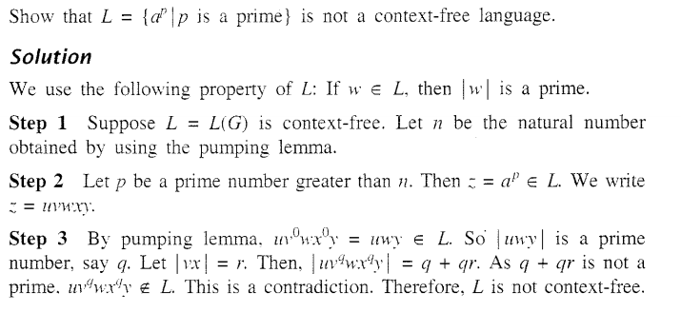

Slide 109
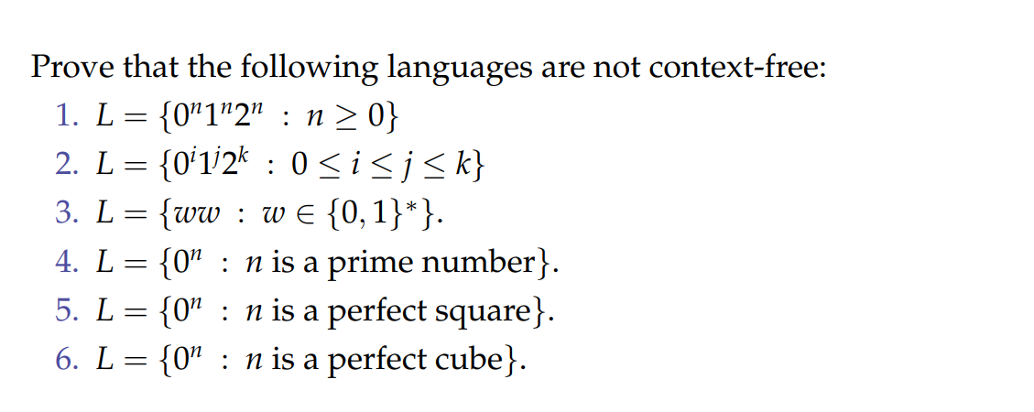
Example

Slide 110
Decision Properties in CFG
Emptiness: We can decide if a CFL is empty (i.e., it has no strings).
Finiteness: We can decide if a CFL has only a finite number of strings.
Membership: We can decide if a string belongs to a CFL (using parsing techniques like CYK algorithm).
Equivalence: Undecidable. We cannot always determine if two CFLs are exactly the same.
Universality (L = Σ*) : Undecidable.
Inclusion (L₁ ⊆ L₂) : Undecidable.

